Slide 1
Chapter 4
Traffic Conflict Studies
Traffic Safety Data Analysis Methods
B. Concept of Traffic Conflicts
C. Methods of Identifying Traffic Conflicts
D. Analysis of Traffic Conflicts
E. Application of Conflict Analysis

Slide 2
A. Traffic Safety Data Analysis Methods
  Purposes of Safety Analysis
  - To find an area with potential safety problems
  - To study the safety performance of a particular safety countermeasure
  - To predict or estimate safety impacts of factors related to roadway, traffic, and control conditions
  Basic Safety Data Analysis Methods
    - Crash data analysis
    - Crash modeling
    - Traffic conflict analysis
    - Traffic flow analysis

Slide 3
3. Basic Problems with Crash Analysis
- The first problem is with the reliability of police reported crash records because the number of crashes tends to be under-reported.
- Crash databases are subject to human error during the input of data. Therefore, code errors, reporting errors and even interpretation errors may appear.
- The waiting time for obtaining an adequate sample size may be too long.
- Other concerns are the randomness of crashes and the human factors associated with them.

Slide 4
B. Concept of Traffic Conflicts
  Interaction between Vehicles
  - Conflict points: A conflict point is defined as the point at which two traffic movements intersect each other.
  Definition of Traffic Conflicts (several definitions)
    - A traffic conflict was defined as an evasive action taken by a driver in order to avoid a collision.
    - A conflict is an observable situation in which two or more road users approach each other in space and time to such an extent that there is a risk of collision if their movements remain unchanged.
    - A traffic conflict is defined as an event involving two or more road users, in which the action of one user causes the other to make an evasive maneuver to avoid a collision.

Slide 5
3. Benefits to Use Traffic Conflicts
- Data can be collected within a short period of time so that an engineer does not have to wait for the occurrence of several crashes to improve the conditions of a site. －more rapidly.
- The effectiveness of a treatment can be evaluated within a short period and if this fails to correct the problem then the countermeasure can be changed again in a very short time . －high effective evaluating method.
- Traffic conflicts include human factors because the behavior of drivers can directly be observed in the field .－identification of human factors.
- Traffic conflict studies can be used with or without crash data since each type of conflict is associated with a particular type of crash. －predication.
- Traffic conflict data provides information about traffic volumes, routine conflicts, moderate conflicts, erratic maneuvers, severe conflicts or near-miss crashes, and other minor crashes, while crash data can only give information on property damage and injury severity.

Slide 6
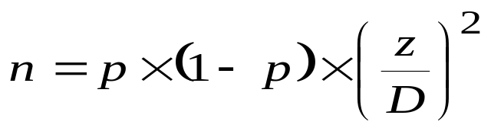
C. Methods of Identifying Traffic Conflicts
  Number of Observations Required
  - Manual of Transportation Engineering Studies
  n = number of vehicles to be counted
  p = expected proportion of vehicles observed that are involved in a conflict
  z = statistic that is based on the level of significance desired
  D = permitted level of absolute error of sample size
  - Example, if one wants to find the sample size, with a level of significance of 5 percent, and with an absolute error of 5 percent, the number of vehicles would be
  n= 0.50 (1-0.50) (1.96/0.05) ²= 384 approach vehicles

Slide 7
  2. Identification of Traffic Conflicts
  - Evasive maneuvers such as applying brakes, swerving, or noticeably decelerating in order to avoid a collision can be considered as conflicts.
  - Brake applications have been usually used as indicators of the occurrence of a conflict.
  - Swerving is also used as an indicator of the occurrence of a conflict, although it may not sometimes be clear whether swerving was because of a conflict or not.
  - Using perception of deceleration of a vehicle is useful for detecting conflicts when there are no brake light indications because of a mechanical failure.
  - Observers are the most important element when conducting a traffic conflict study because their reliability has a serious impact on the validity of the data. Therefore, training and educating observers are the most important factors considered in the initial stages.

Slide 8
D. Analysis of Traffic Conflicts
  Conflict Severity
  - Based on conflict type, such as: right-turn conflict is more severe than rear-end conflict.
  - Based on field observation: (1) objective method and (2) subjective method!
  Conflict Severity Evaluated by Objective Method
  - Objective methods rely on physical properties such as time, distance, and speed.
  - Time to Collision (TTC) is used to evaluate conflict severity. TTC is defined as the time required for two vehicles to collide if they continue at their present speeds on the same paths.

Slide 9
  3. Conflict Severity Evaluated by Subjective Method
  - Subjective measures rely on human observers to record the perceived risk at the moment in which the conflict occurred.
  - Risk Of Collision (ROC) is used to evaluate the severity of conflicts, ROC is based on the severity of the risk perceived while collecting data in the field.
  Severity Score Values
ROC Scores
TTC (seconds)
ROC
1
1.51 – 2.00
Low Risk
2
1.00 – 1.50
Medium Risk
3
0.00 – 0.99
High Risk

Slide 10
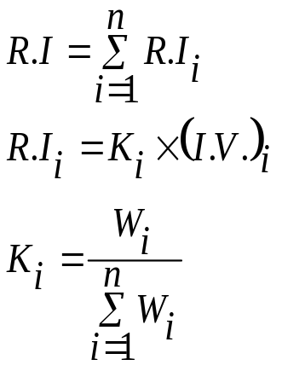
  Conflict Risk Index
  RI = total risk index for intersection
  RI_{i} = risk index for conflict type i at intersection
  K_{i} = relative weight for conflict type i
  W_{i} = weighting factor for conflict type i (the weighting factor is based on a subjective scale, which ranged from 1 to 3, 1 for the least severe conflict, and 3 for the most severe conflict - could use the severity score values.)-Be careful.
  (I.V.)_{i} = indicator value for conflict type i at intersection (the indicator value corresponds to the number of conflicts per thousand entering vehicles on the site – conflict rate.)
  n = number of conflict types

Slide 11
  Example of Conflict Risk Index
conflics | Number/1000 | K_{i} | (I.V.)_{i} | RI_{i}
Head-on | 5 | 0.6 | 1/6 | 0.1
Left-turn | 10 | 0.3 | 1/3 | 0.1
Right-turn | 15 | 0.1 | 1/2 | 0.05
RI |  |  |  | 0.25

Slide 12
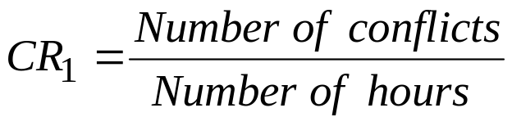
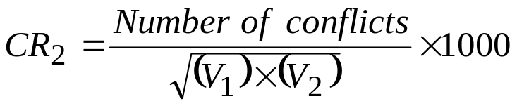
  6. Conflict Rate
  CR₁ = conflict rate 1
  CR₂ = conflict rate 2
  V₁and V₂ = interacting traffic volumes
Rate Type | Definition
Conflicts per Hour
Conflict Per Thousand Involved Vehicles

Slide 13
E. Application of Conflict Analysis
<高速公路爬坡车道、交织区、分合流区>
1. 爬坡车道
在高速公路纵坡较大的路段，由于受爬坡性能的限制，单位质量功率低的载重车爬坡时需要克服较大的坡度阻力，车速降低过多，而小型车车速受坡度影响较小，造成载重车与小型车的速度差变大，超车需求和加、减速频率增大，驾驶行为频繁改变，爬坡路段的交通流发生紊乱，极易发生追尾、侧碰等交通事故，导致爬坡路段交通安全水平显著下降。同时，重型车混合率的增大也必将减小小汽车的行驶自由度，导致爬坡路段通行能力以及服务水平的降低。
为有效消除不利影响，在爬坡路段增设爬坡车道是一种较好的解决方案。通过增设爬坡车道，将载重车从主线交通流中分离出去，以提高小型车的行驶自由度，确保行车安全。

Slide 14
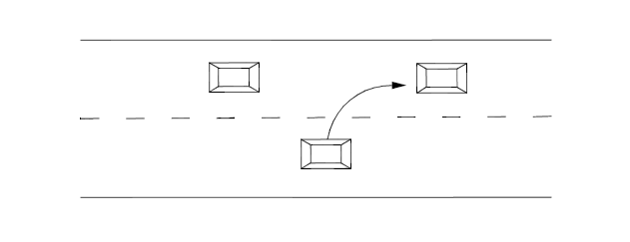
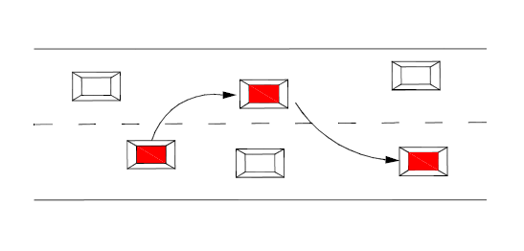
E. Application of Conflict Analysis
<高速公路爬坡车道、交织区、分合流区>
1. 爬坡车道
（2）换车道冲突：车辆需要转换行驶方向进行变换车道的过程中，与被穿越车道上行驶的车辆之间有导致追尾或者侧撞的可能。
（3）超车冲突：跟随车辆因不满足目前的行驶状态而试图超越前车的过程中，有导致其与前车或相邻车道上的车辆发生侧撞的可能。

Slide 15
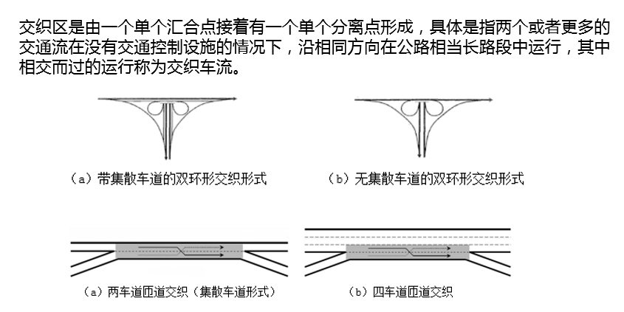
E. Application of Conflict Analysis
<高速公路交织区、分合流区>
1. 交织区

Slide 16
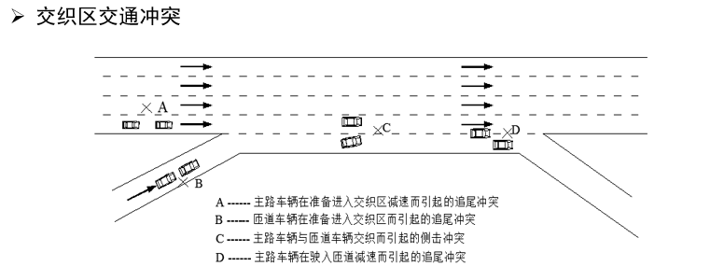
1. 交织区

Slide 17
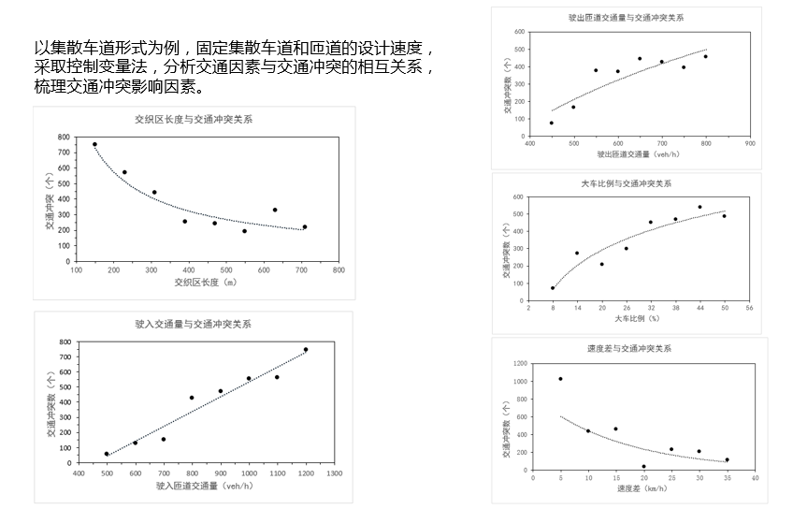
1. 交织区
交织区交通冲突因素分析

Slide 18
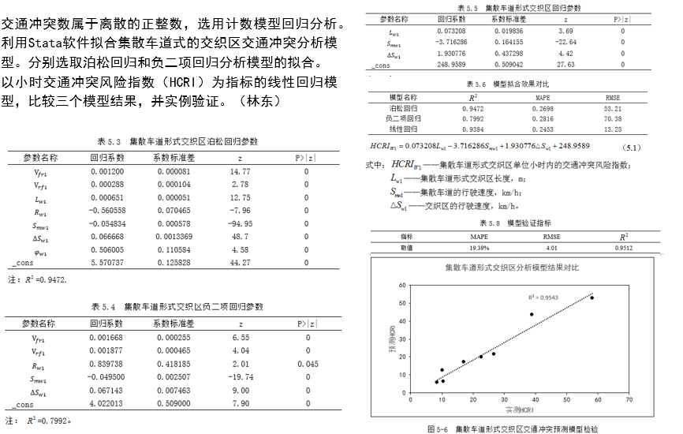
1. 交织区
有集散车道的交织区

Slide 19
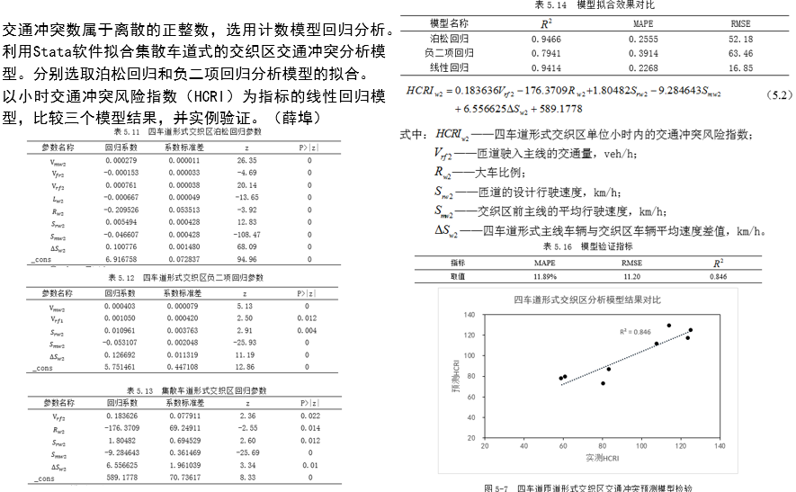
1. 交织区
交织区-四车道形式

Slide 20
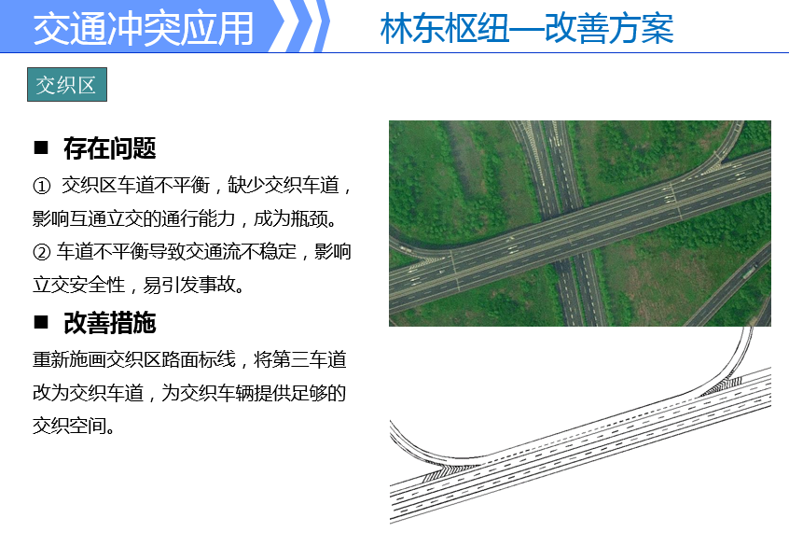
1. 交织区

Slide 21
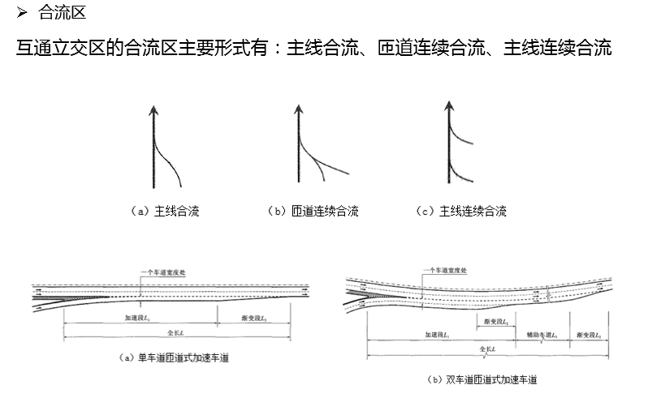
2. 合流区

Slide 22
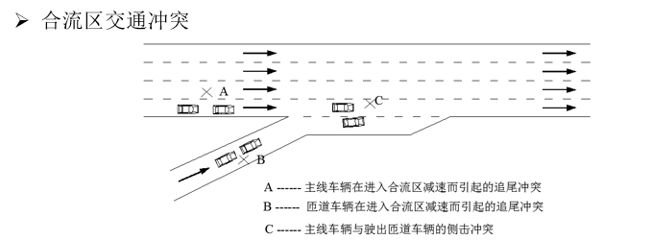
2. 合流区

Slide 23
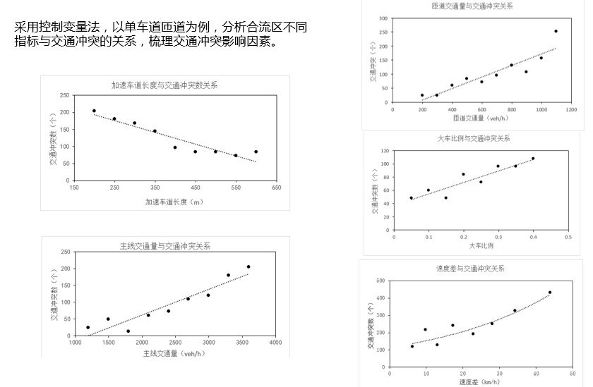
2. 合流区
合流区交通冲突因素分析

Slide 24
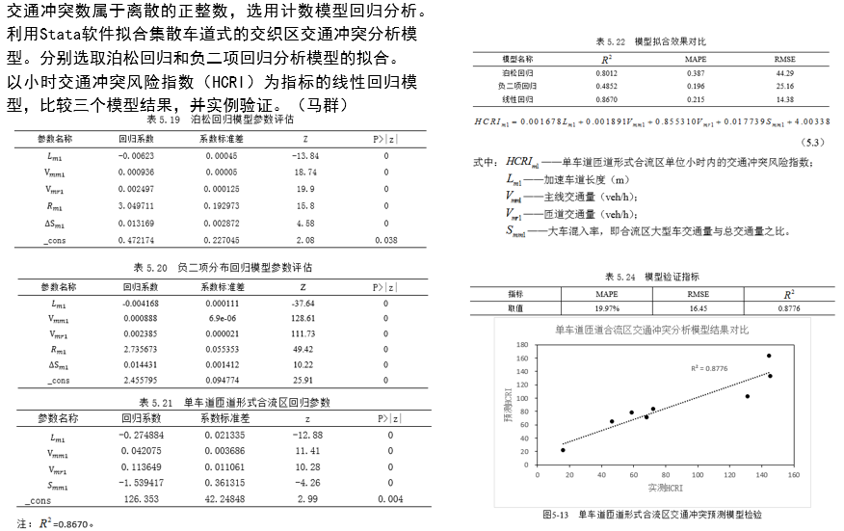
2. 合流区
合流区-单匝道车道

Slide 25
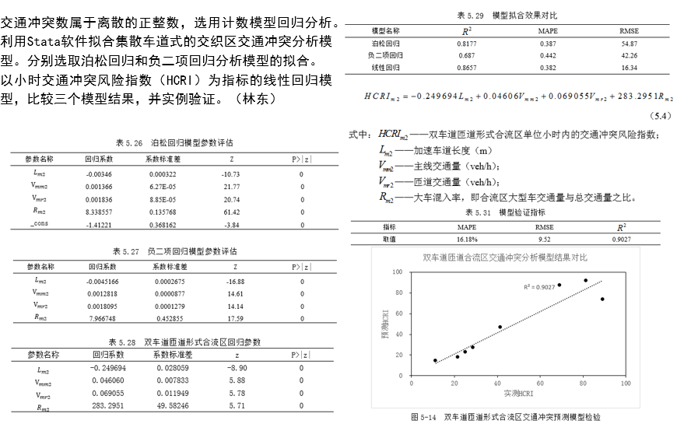
2. 合流区
合流区-双匝道车道

Slide 26
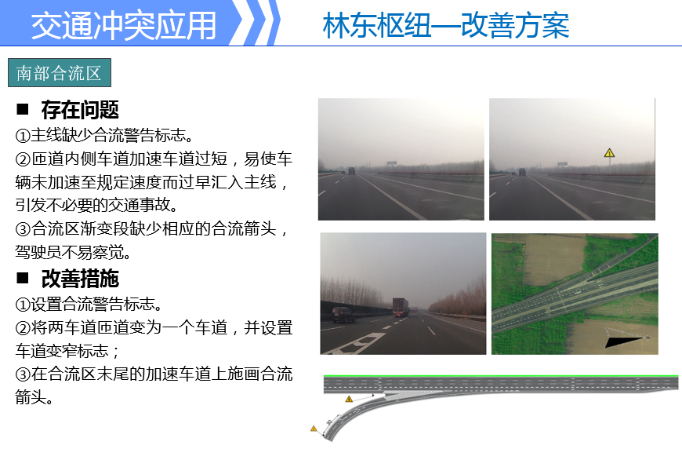
2. 合流区

Slide 27
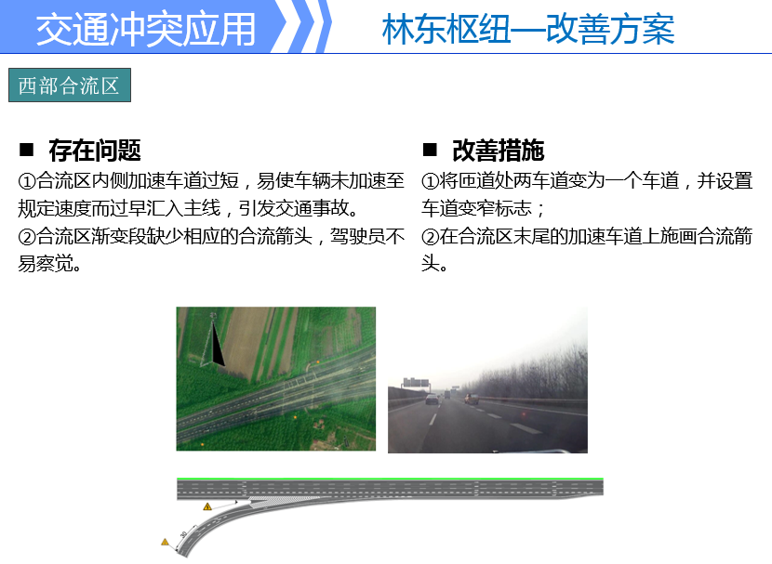
2. 合流区

Slide 28
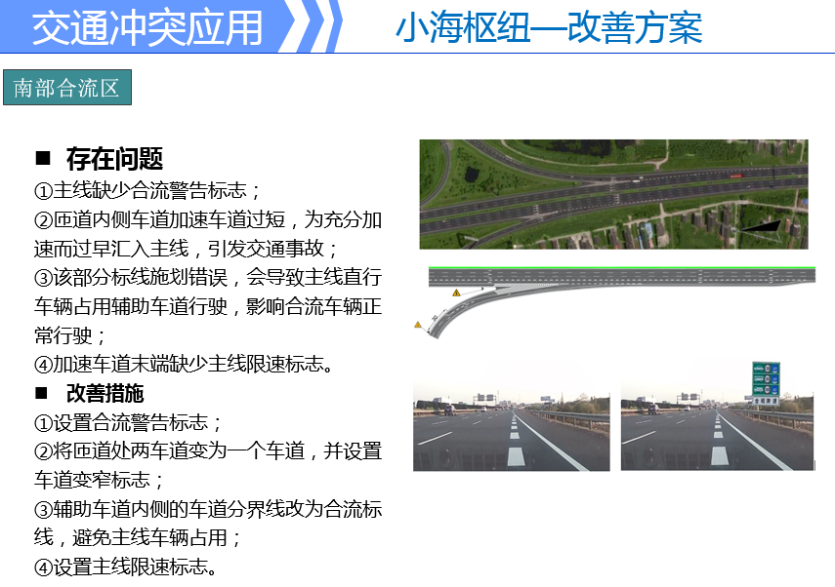
2. 合流区

Slide 29
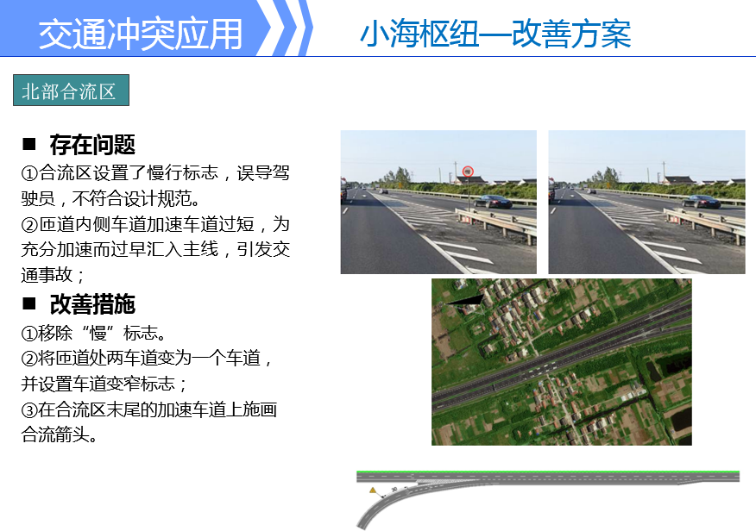
2. 合流区

Slide 30
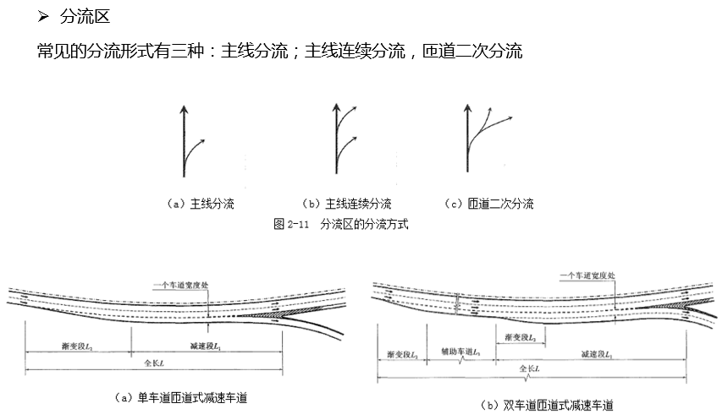
3. 分流区

Slide 31
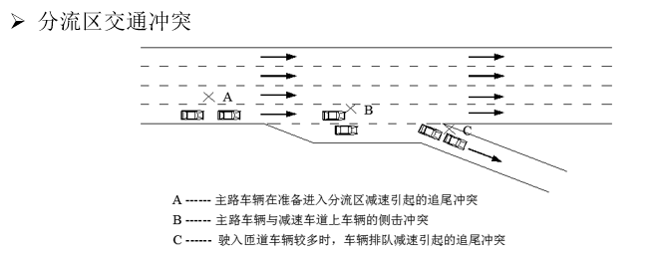
3. 分流区

Slide 32
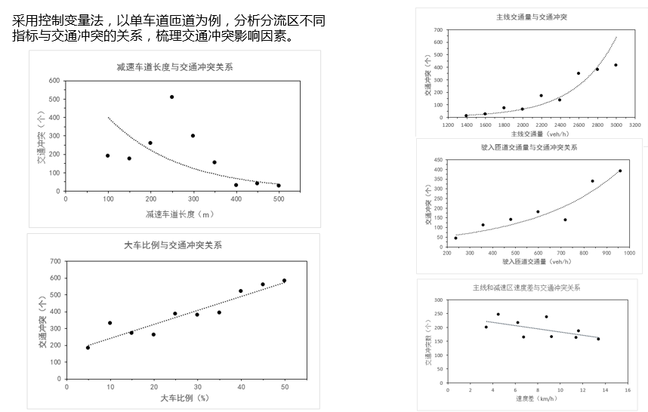
3. 分流区
分流区交通冲突因素分析

Slide 33
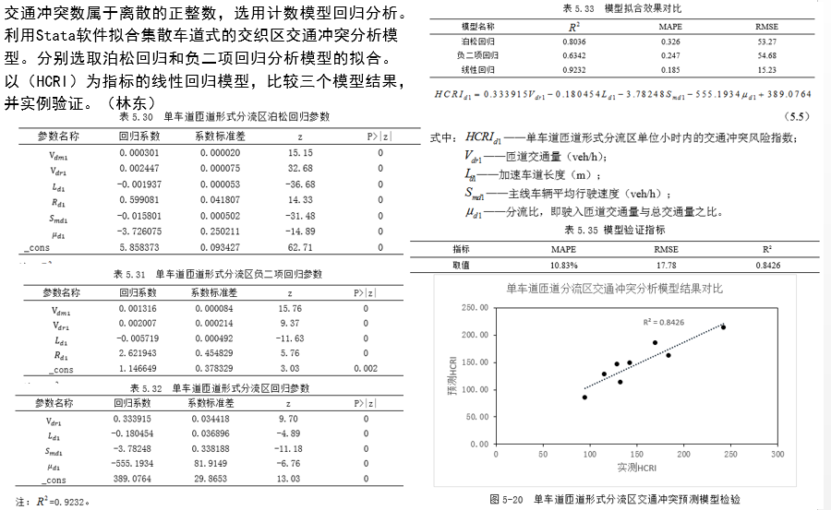
3. 分流区
分流区-单匝道车道

Slide 34
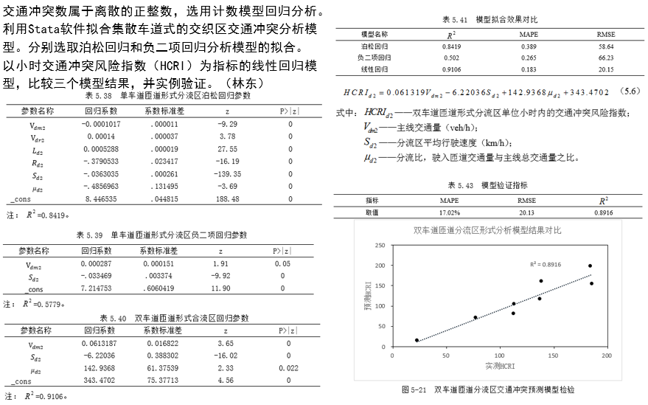
3. 分流区
分流区-双匝道车道

Slide 35
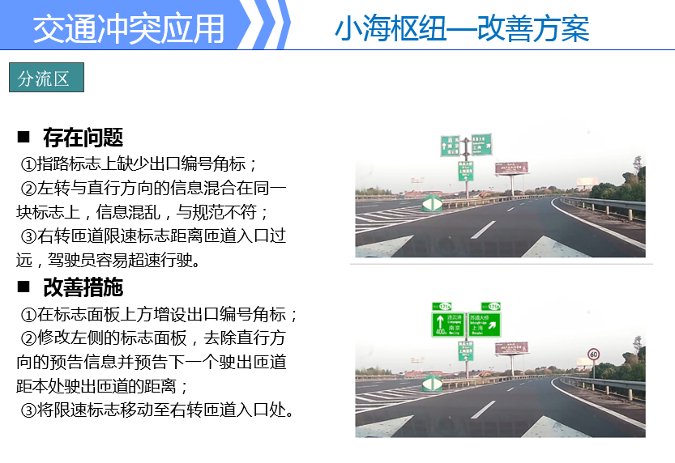
3. 分流区

Slide 36
End
Homework No. 2

Slide 37
Evasive Action
Collision
Conflict
Potential Collision Situation
No Evasive Action
No Collision
No Conflict

Slide 38
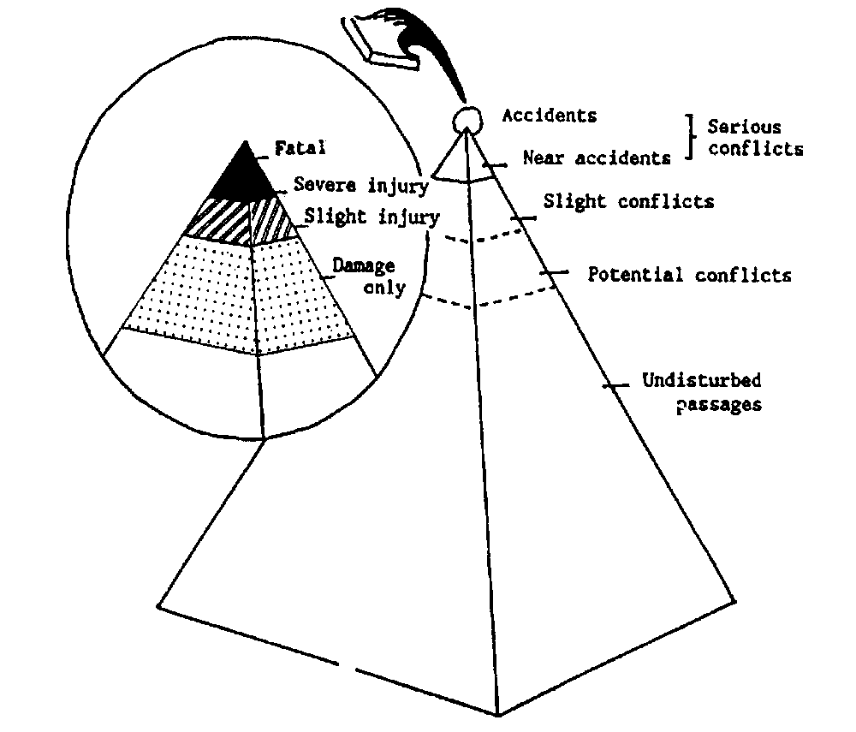

Slide 39
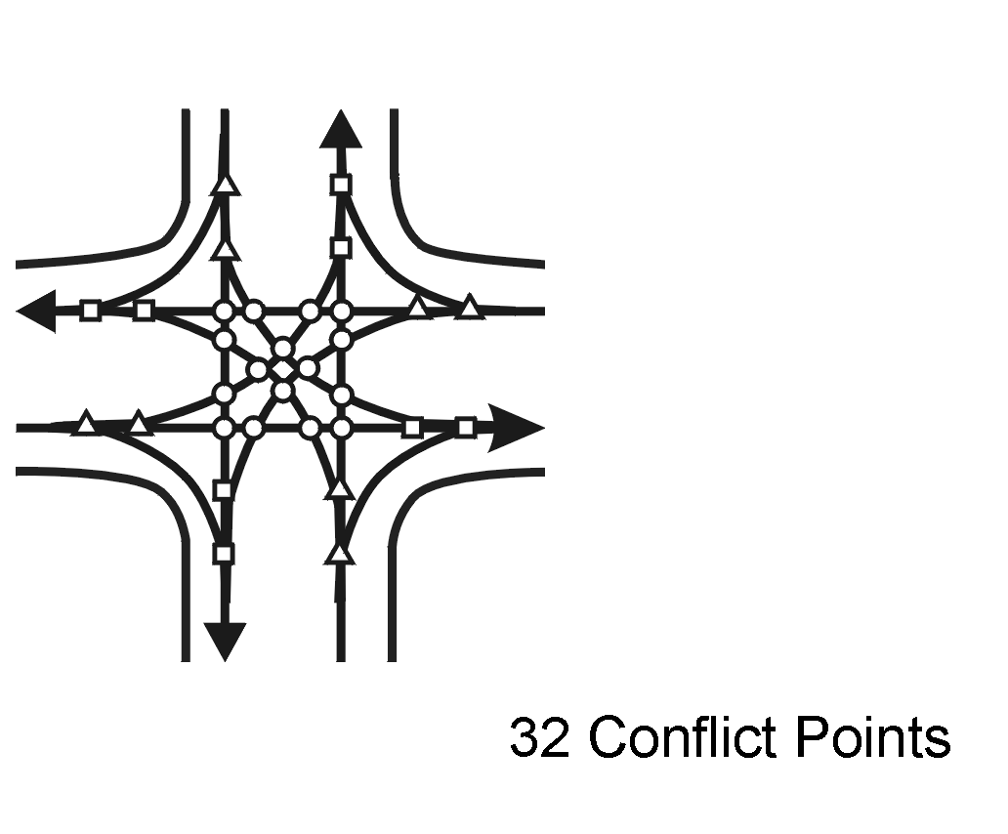
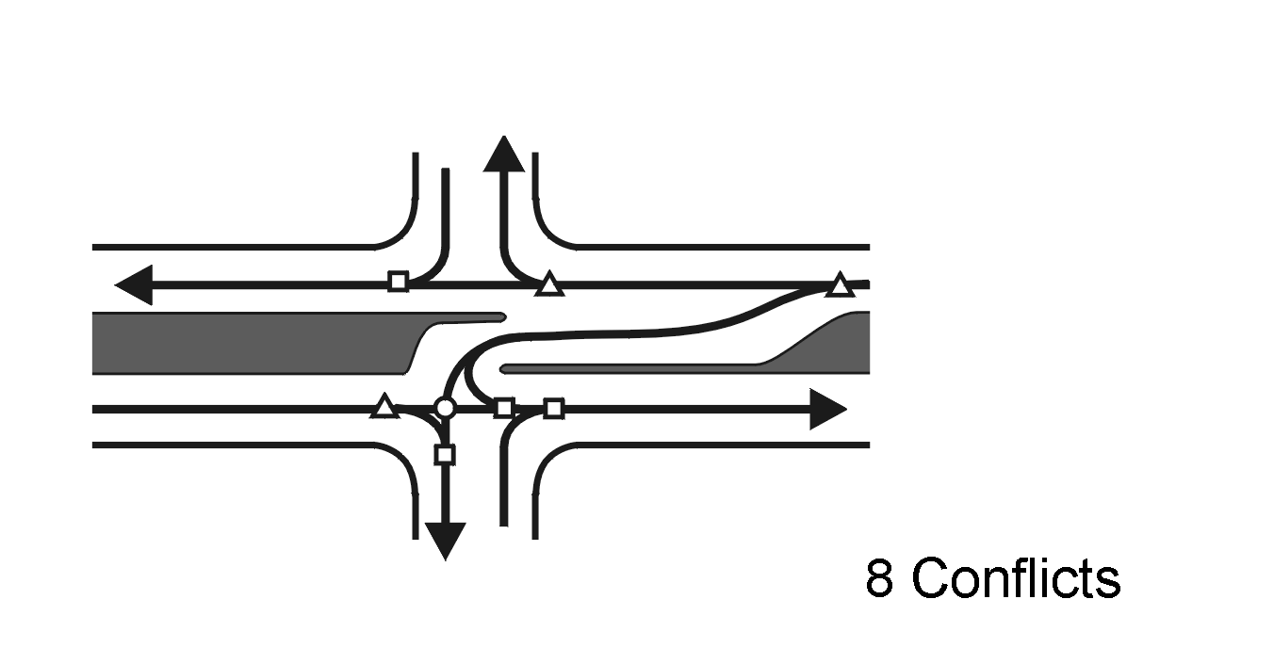

Slide 40




Slide 41
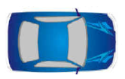


Slide 42
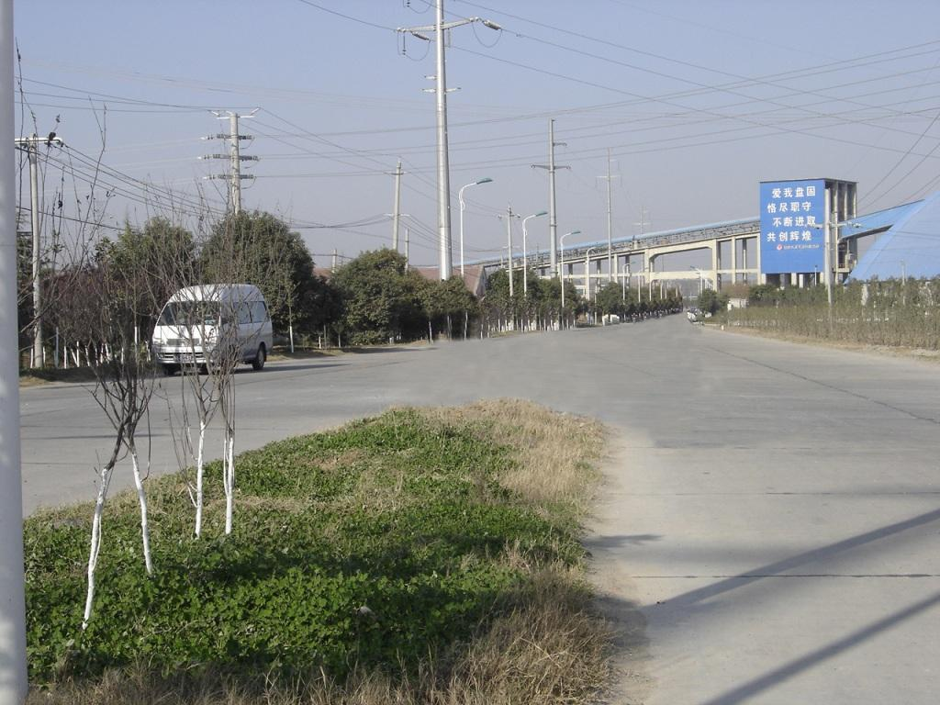
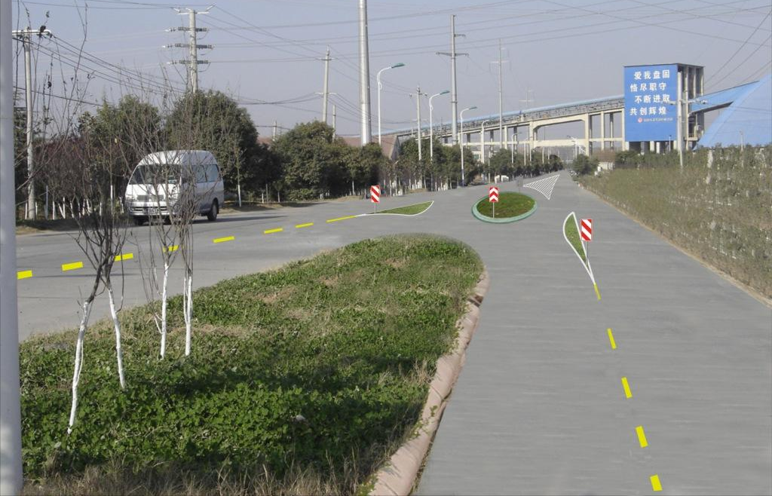

Slide 43
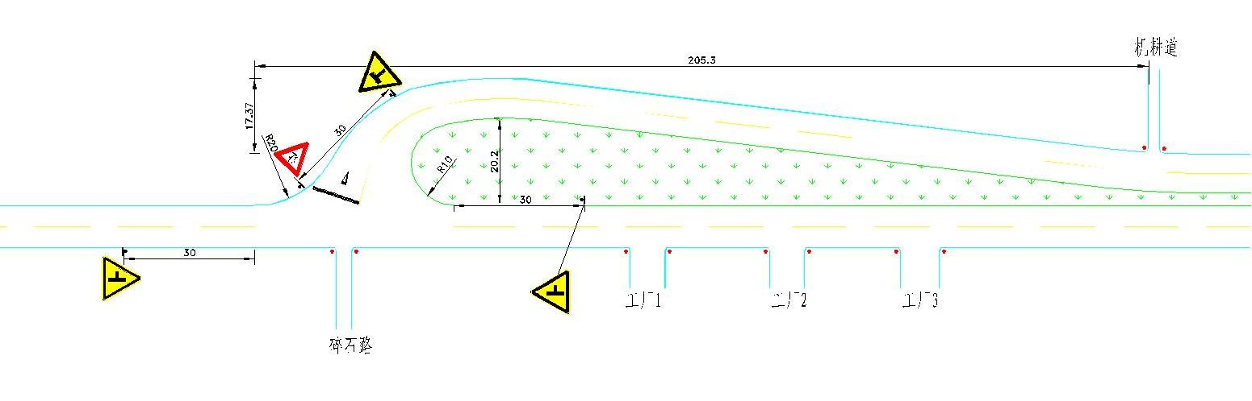
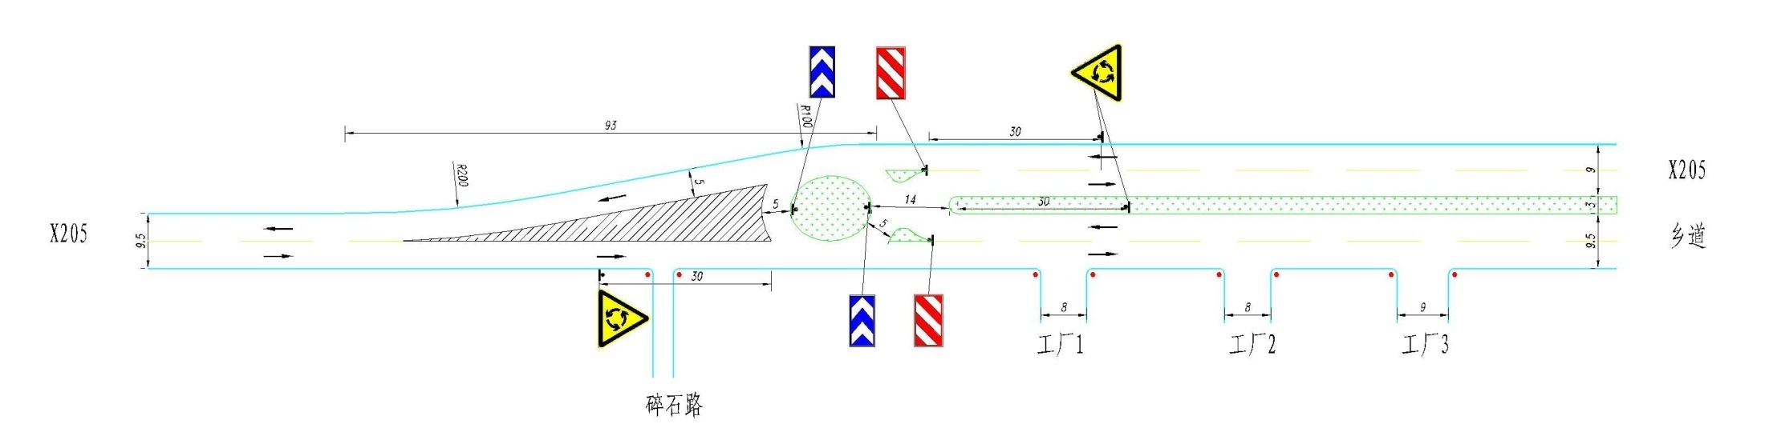

Slide 44
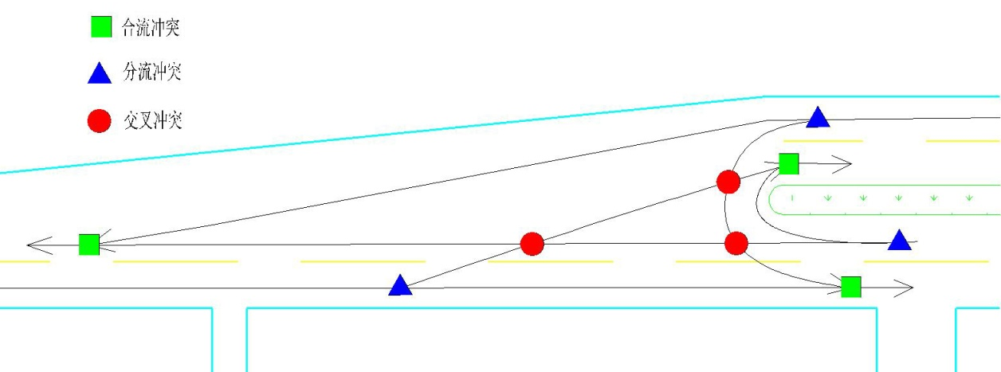
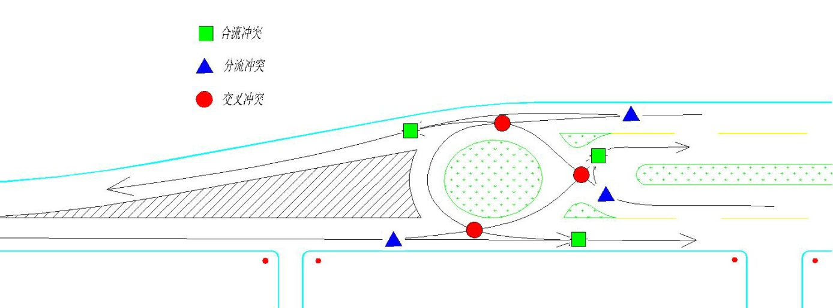
改善前冲突点示意图
改善后冲突点示意图

Slide 45
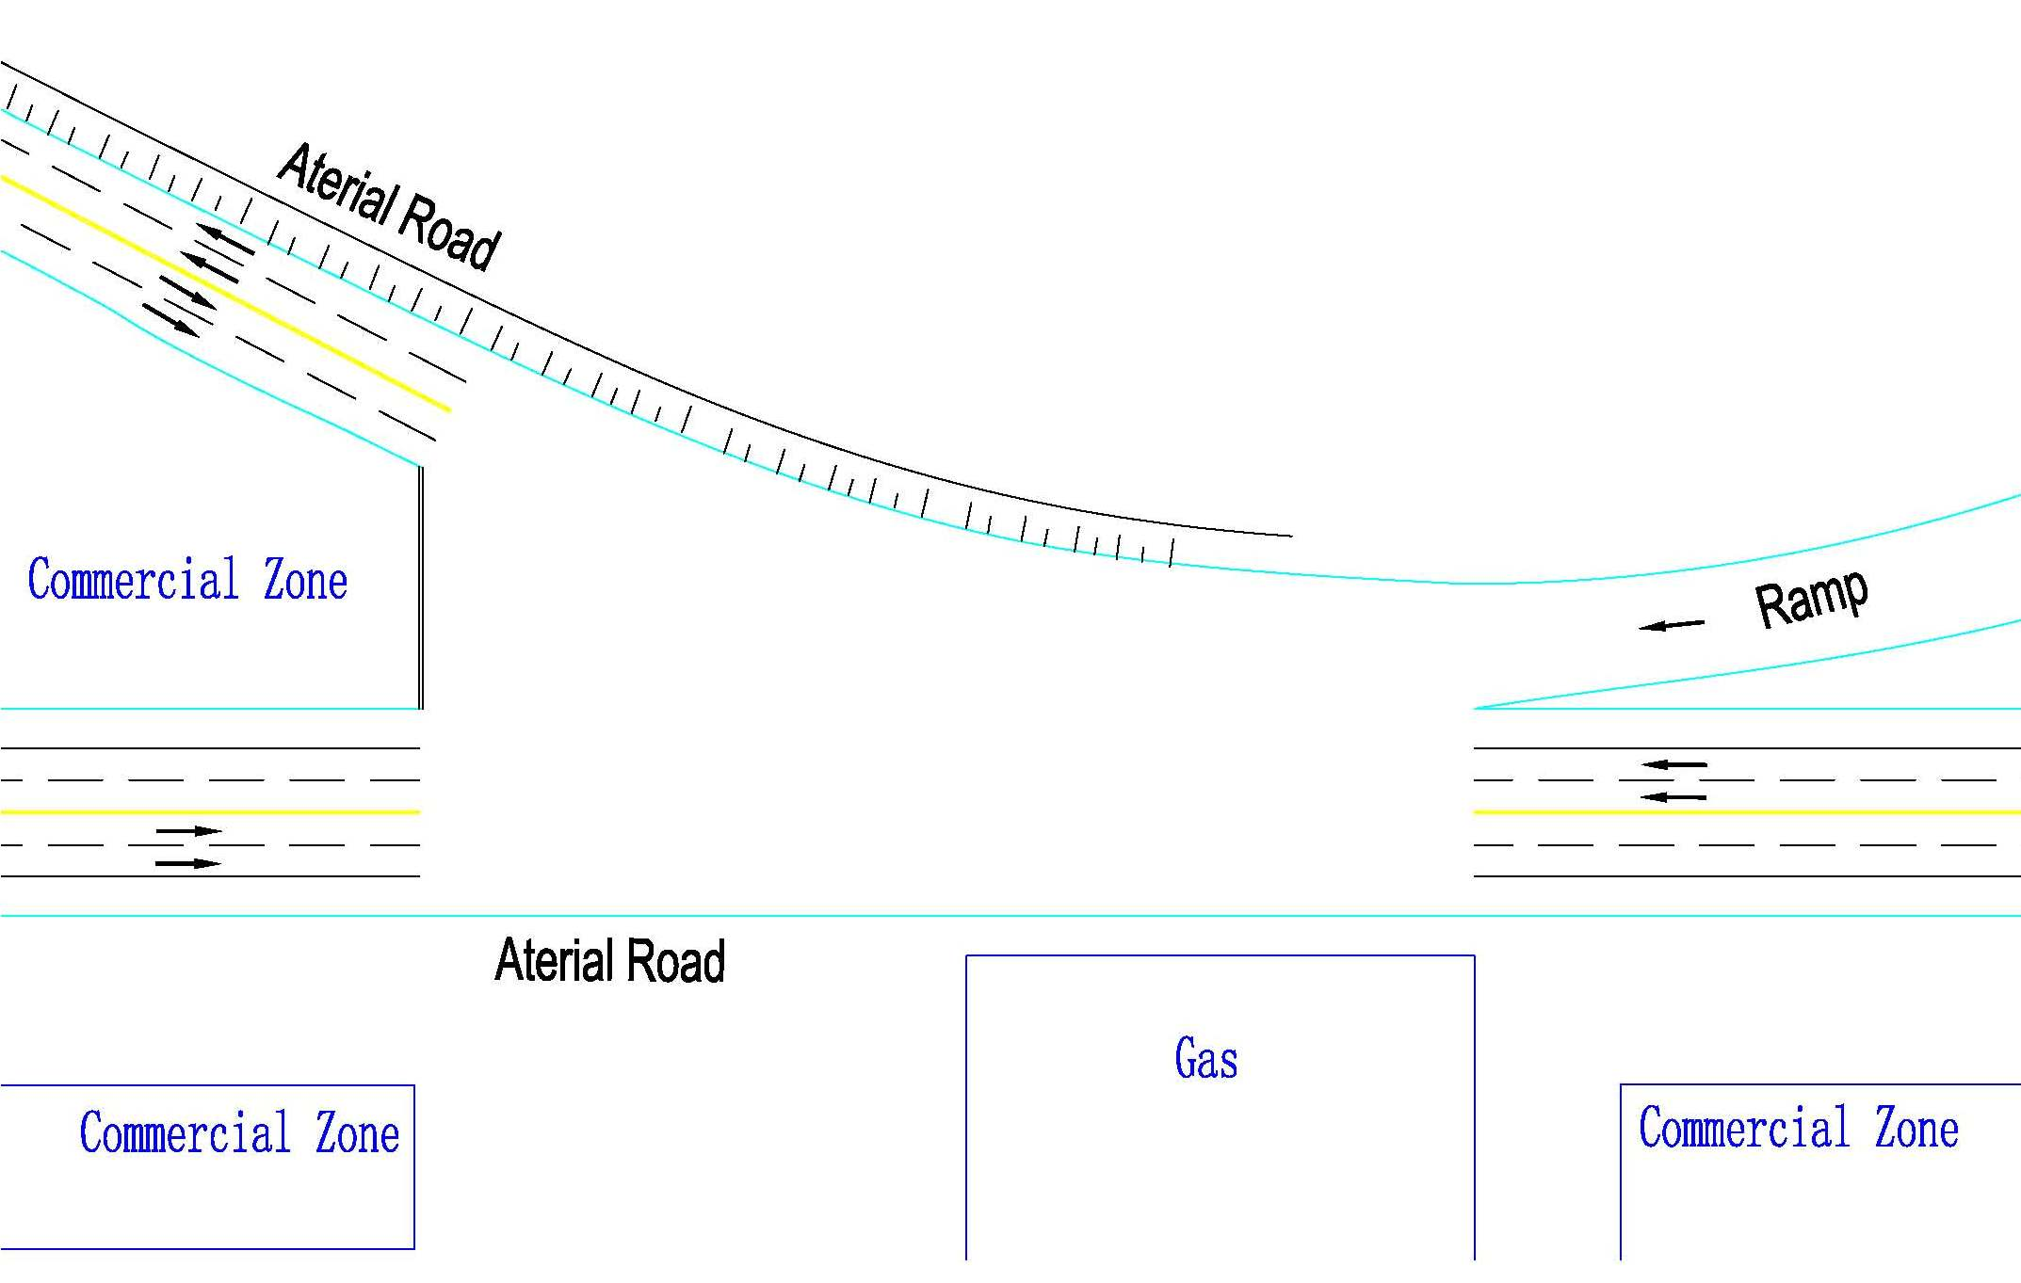
Homework No. 2
1、一无信号控制交叉口平面图如下，应用掌握的交通冲突技术，分析其主要冲突类型、冲突严重性，提出交通安全设计的建议和设计方案。

